Slide 1

Petals to the Metal Flower Classification
“The Machine Learning Mavericks”
Team: Cindy Chen & Aiden Gray
Mentor: Tarek Radi

Slide 2
Background:
Objective: Classifying flowers into 104 flower types on Intel’s Developer Cloud (using CPUs), Locally (using CPUs) and on Kaggle (using TPUs)
Data input format: Binary TFRecord format
(includes picture and labels)
Datasets
Training dataset: 12,753 Training images predict the outcome you design your model to predict.
Datasets size: 192 * 192, 512 * 512
2. Validation dataset: 3,712 validation images w / labels intended to calculate the model’s performance.
3. Test dataset: 7,382 unlabeled test images to predict flower classification.
Notes:
Background

Slide 3
Workflow Strategy
01
02
03
04
Loading datasets
Data Preprocessing
Explore data
Visual validation
Import libraries
Distribution Strategy (detect TPUs, if any)
Create data pipeline
Scaling the data
Data augmentation
Train the model
Evaluate the model
Analyze the confusion matrix
Display batch of images
Print predictions

Slide 4
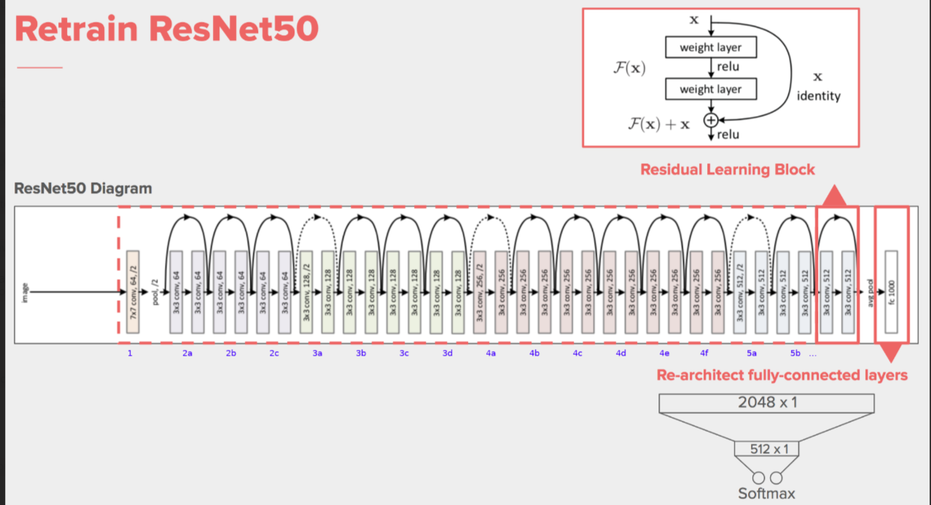
ResNet50 Model
TensorFlow Keras is a high-level neural network API for building and training deep learning models.
ResNet-50 is a convolutional neural network that is 50 layers deep and it can load a pre-trained version of the network trained on more than a million images from the ImageNet database.
ResNet 50V2 is considered to be a more accurate and robust model than the original ResNet50.
General Parameters used:
EPOCHS = 90
BATCH_SIZE = 128
NUM_TRAINING_IMAGES = 12753
STEPS_PER_EPOCH = 10

Slide 5
Intel DevCloud
Parameters | Checkout Point 1 |  | Checkout Point 2 |  | Final Presentation
Owner | Cindy | Cindy | Cindy | Cindy | Cindy | Cindy
Execution Location | DevCloud | DevCloud | DevCloud | DevCloud | DevCloud | DevCloud
Model | ResNet50 | ResNet50 | ResNet50 | ResNet50V2 | ResNet50V2 | ResNet50V2
Callbacks | EarlyStopping | LearningRateScheduler | ReduceLROnPlateau | ReduceLROnPlateau_callback | ReduceLROnPlateau_callback | ReduceLROnPlateau_callback
Epochs | 90 | 90 | 90 | 90 | 90 | 90
Image prep | X | X | X | X | X | X
 | - | - | - | X | X | X
 | - | - | - | X | X | X
 | - | - | - | X | X | X
 | - | - | - | X | - | X
Steps per epoch | 10 | 10 | 10 | 10 | 10 | 10
Image size | 192x192 | 192x192 | 192x192 | 192x192 | 192x192 | 192x192
BATCH SIZE | 16 * 8 | 16 * 8 | 16 * 8 | 16 * 8 | 16 * 8 | 16 * 8
Optimizer | Nadam | Nadam | Nadam | RMSprop | Nadam | Nadam
Recall | NA | 0.625 | 0.686 | 0.832 | 0.836 | 0.84
Precision | NA | 0.764 | 0.833 | 0.861 | 0.872 | 0.869
F1 score | NA | 0.625 | 0.717 | 0.841 | 0.848 | 0.849

Slide 6
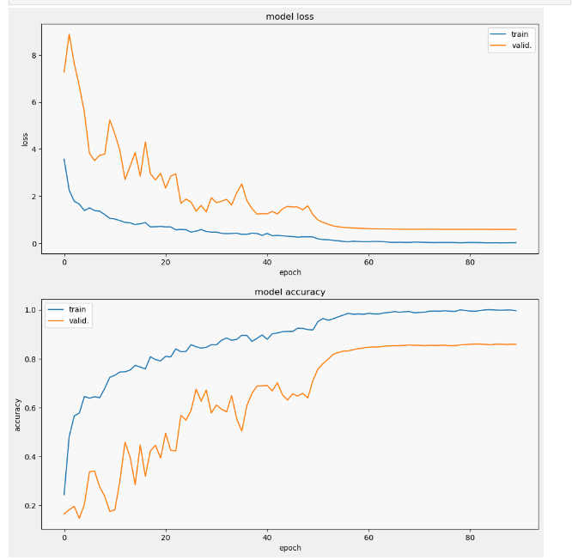
ResNet 50 V2 Model loss & Model accuracy
(Intel DevCloud)

Slide 7
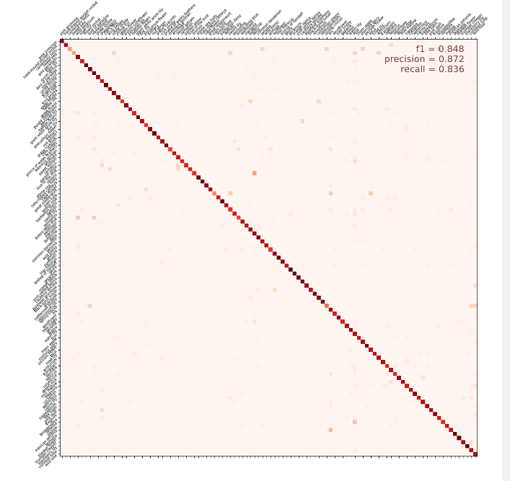
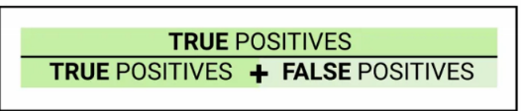
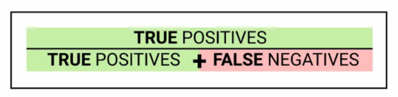
ResNet 50 V2 Confusion Matrix
Precision = 0.872
Recall = 0.836
F1 – Score = 0.848
Balances the Precision and Recall score:
F1 = 2 * (Precision * Recall) / (Precision + Recall)

Slide 8
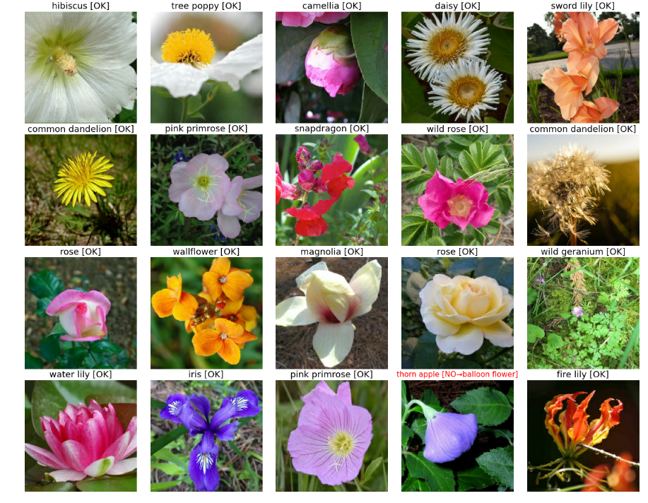
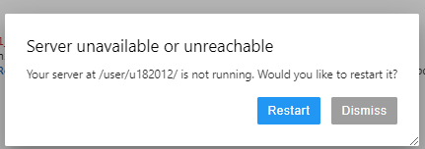
Visual Validation
Limitations:
No TPU only CPU
The model takes a long time to run [~3 hours] and accuracy was not as high as we hoped
Sever stop running after certain hours
Epochs = 90 is the highest epoch

Slide 9
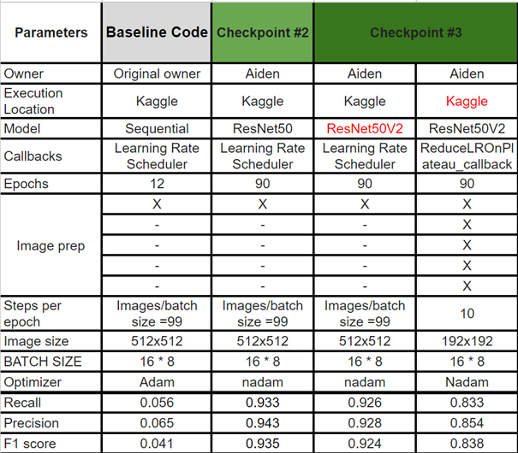
Kaggle

Slide 10
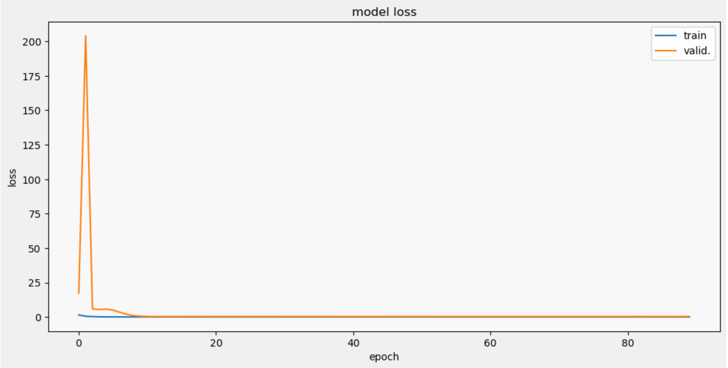
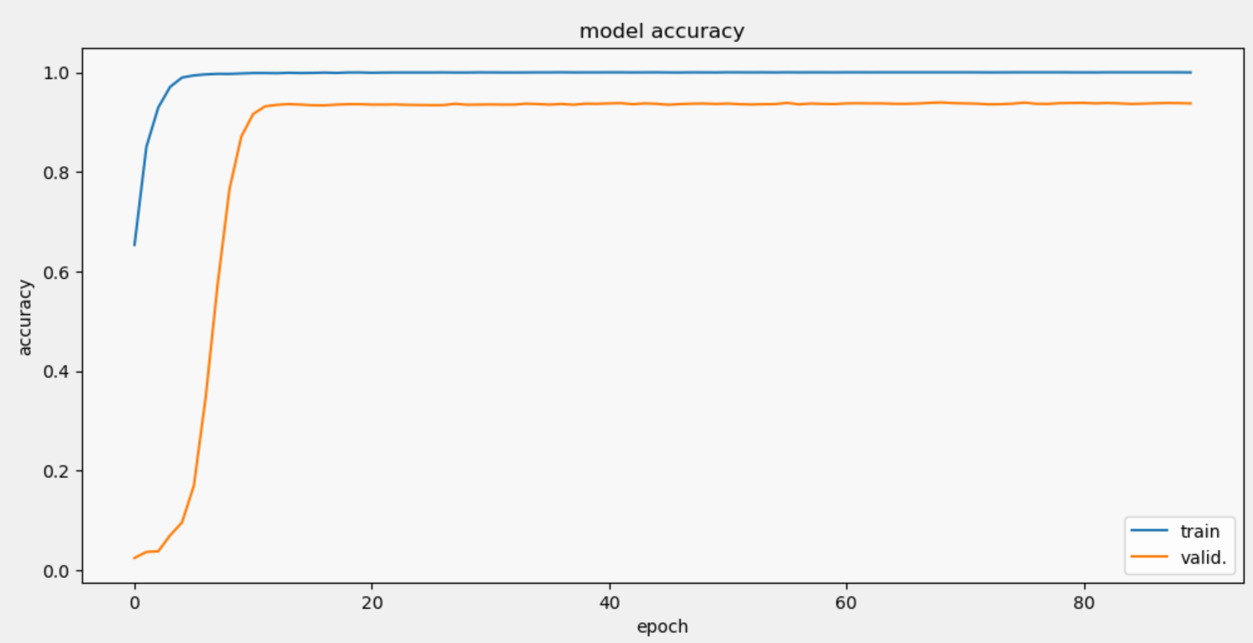
ResNet 50 Model loss & Model accuracy (Kaggle)
Epoches: 90
Batch Size: 99
Callback: LearningRateScheduler
Image Size: 512 x 512
TPUs

Slide 11
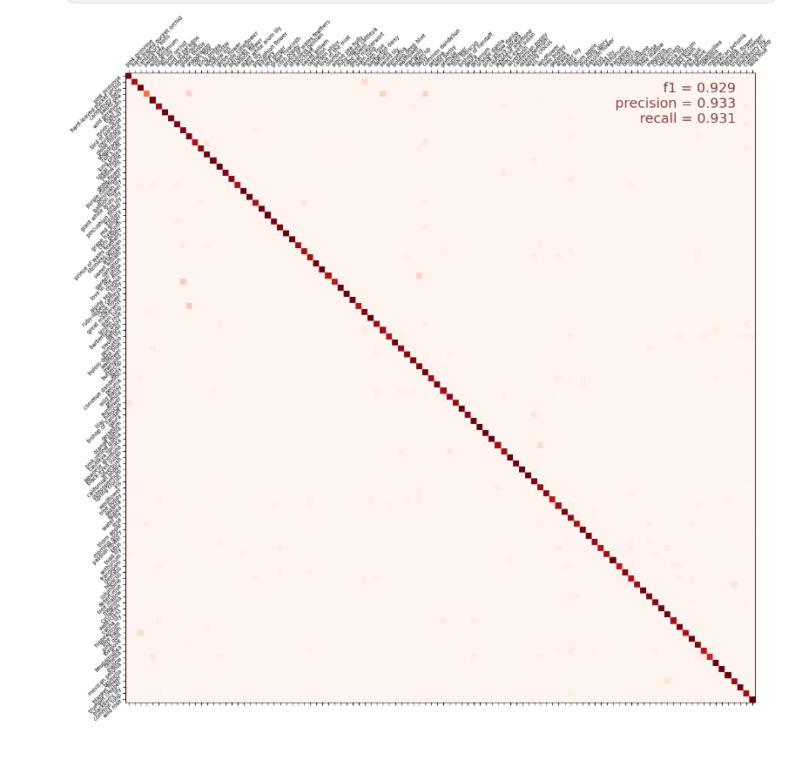
ResNet 50 Confusion Matrix (Kaggle)
Precision = 0.933
Recall = 0.931
F1 – Score = 0.929
Balances the Precision and Recall score:
F1 = 2 * (Precision * Recall) / (Precision + Recall)

Slide 12
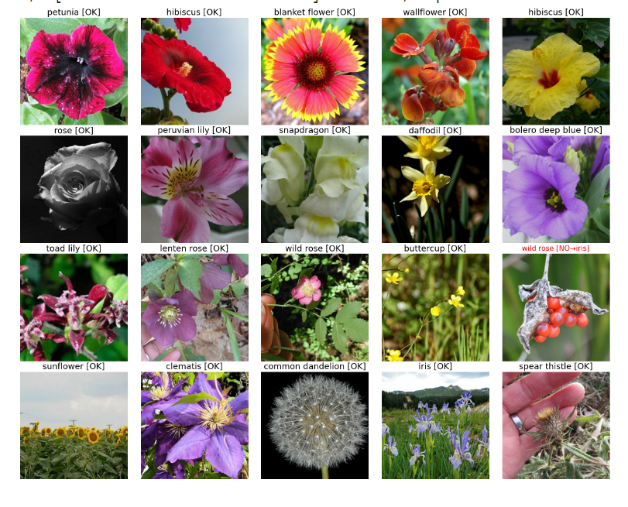
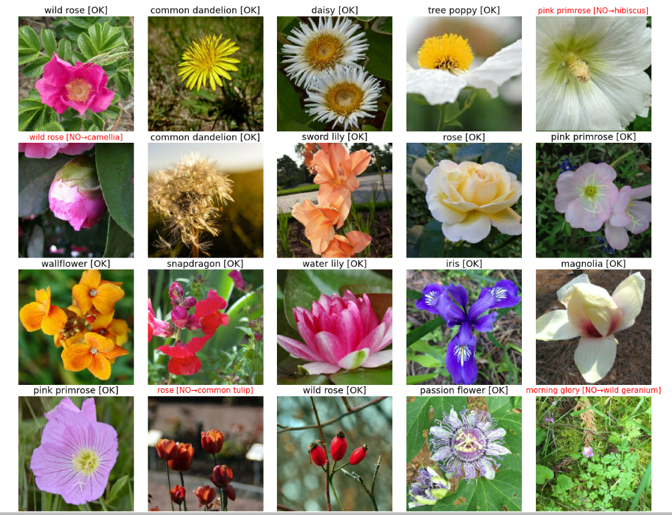
Visual Validation
Limitations:
TPU
The model takes 45 minutes to run and accuracy is higher than through Intel DevCloud
Server has not stopped yet
Epochs = 90 is the highest tried

Slide 13
Local Server Experimentation
Model: Resnet50
Callback: Learning Rate Scheduler
Epochs: 10
Image Size: 192x192

Slide 14
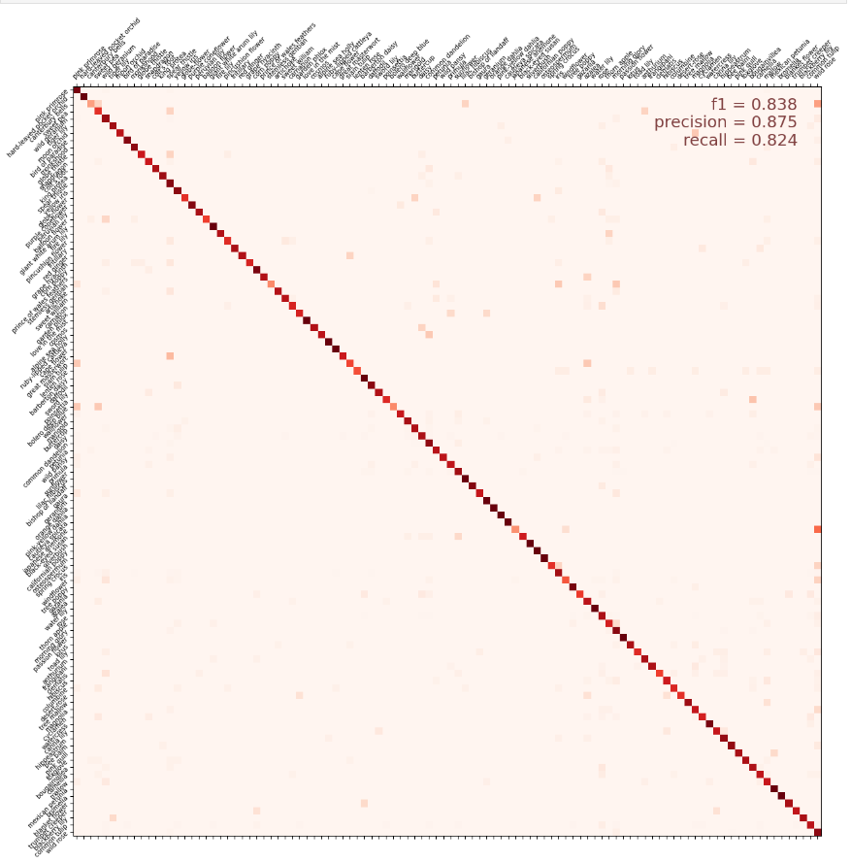
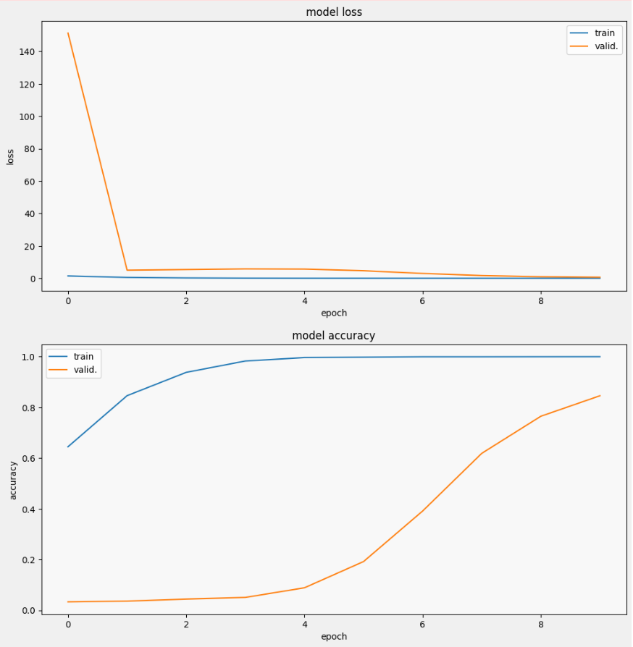
ResNet 50 Model loss & Model accuracy & Confusion Matrix (Local)

Slide 15
Limitations of local servers
It cannot handle large image sizes
512 x 512
It takes too long per epoch to run the code multiple times
13 min per epoch

Slide 16
Learning Journey - Aiden
MO:
None
Start
Progress
Now
MO:
Read documentation
Study others’ codes
Write code
Test and repeat

Slide 17
Learning Journey Cindy
MO: Python Beginner Don’t know ML Challenge
Start
Progress
Now
MO:
Research
Build ML model from the beginning
Don’t give up!!
MO:
Build ML
Improve model accuracy
Growth mindset

Slide 18
Thank You

Slide 19
Appendix:
ReduceLROnPlateau callback:
ReduceLROnPlateau_callback = tf.keras.callbacks.ReduceLROnPlateau(monitor='val_loss', factor=0.1, patience=10, verbose=0, mode='auto', min_delta=0.0001)
The above code snippet says that if the val_loss has not improved (the lower the better) for 10 epochs then it will change the learning rate to its 1/10 th value.

Slide 20
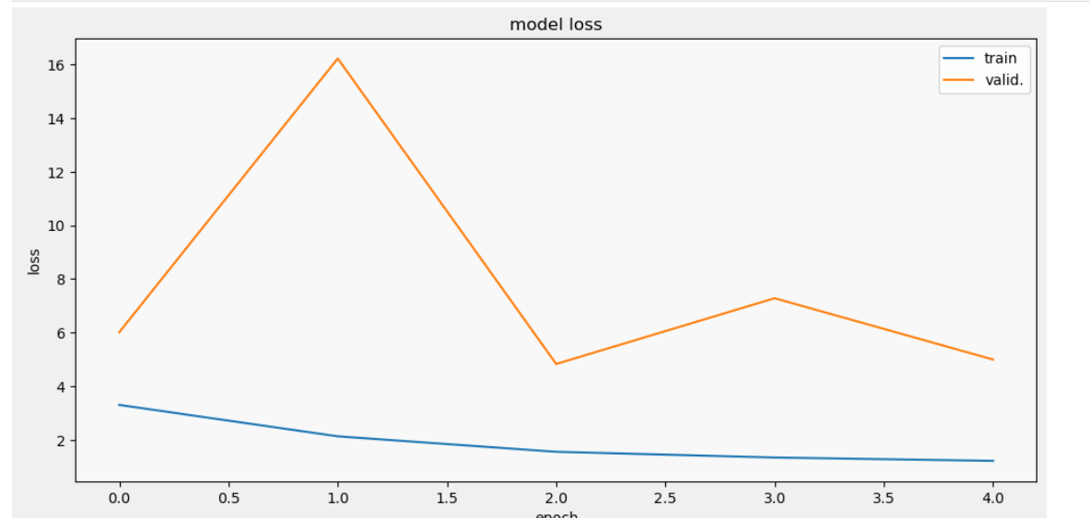
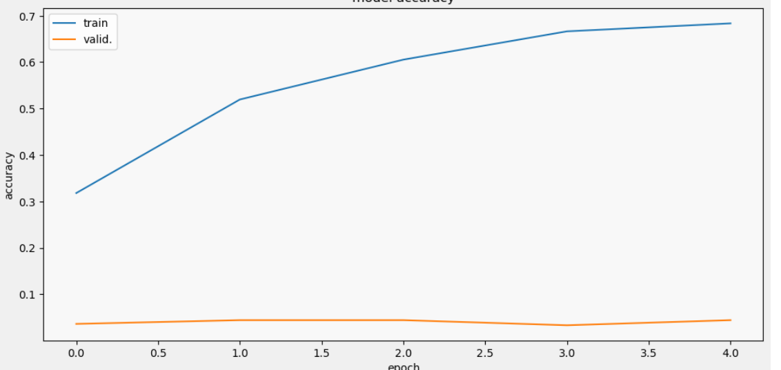
Appendix:
Earlystop callback:
early_stop = tf.keras.callbacks.EarlyStopping(monitor='val_loss', min_delta=0, patience = 2, mode='auto')

Slide 21
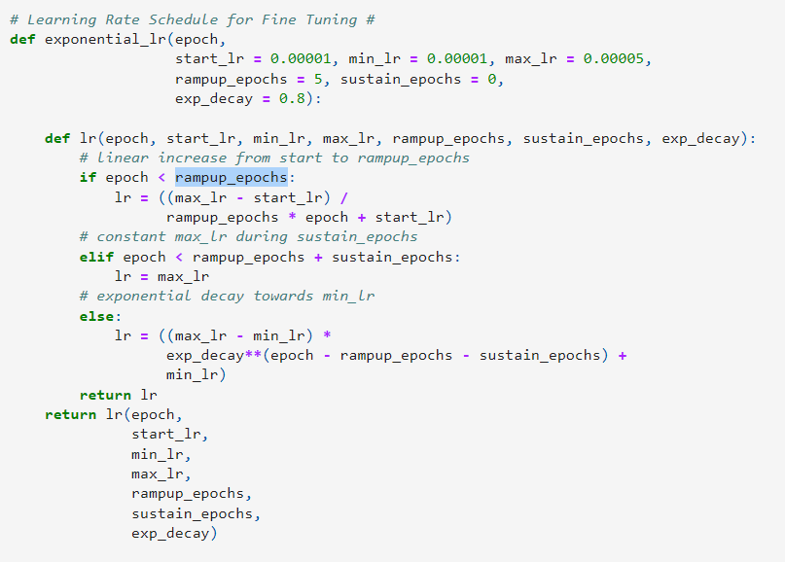
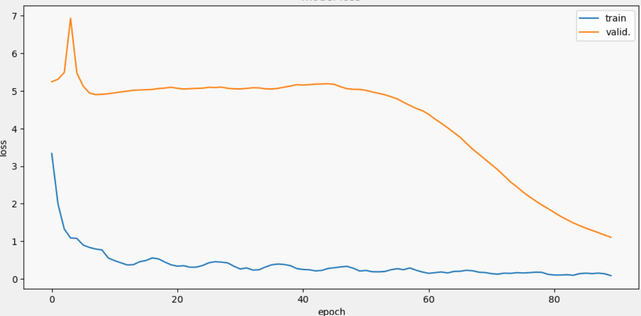
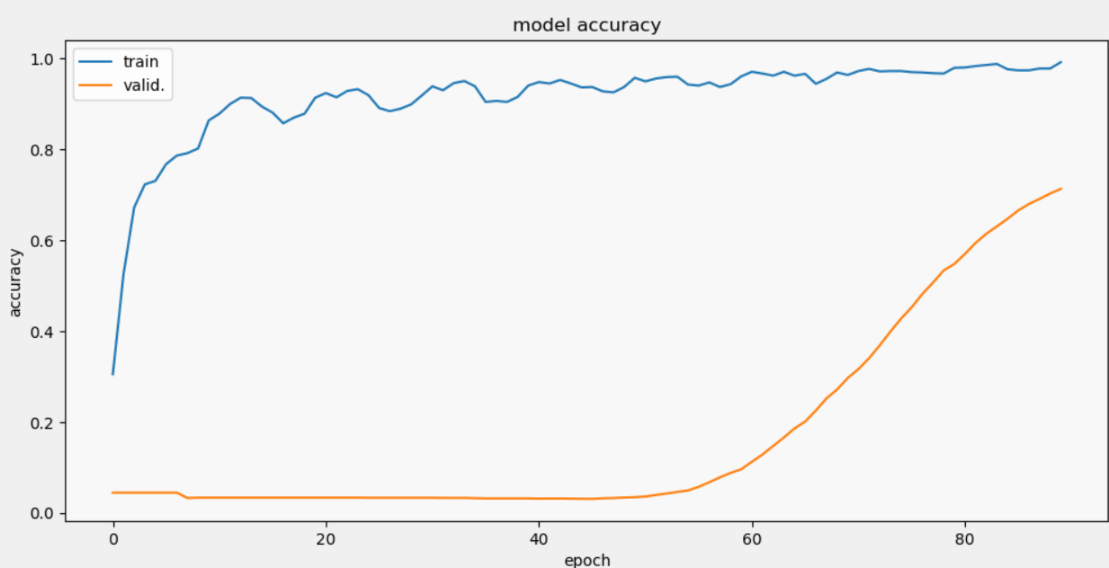
Appendix:
Ir callback:
lr_callback = tf.keras.callbacks.LearningRateScheduler
(exponential_lr, verbose=True)

